Slide 1
Memory Management Hardware
BY: Mokshesh,Shanmukaha,Rajesh,Hussain,Narendra

Slide 2
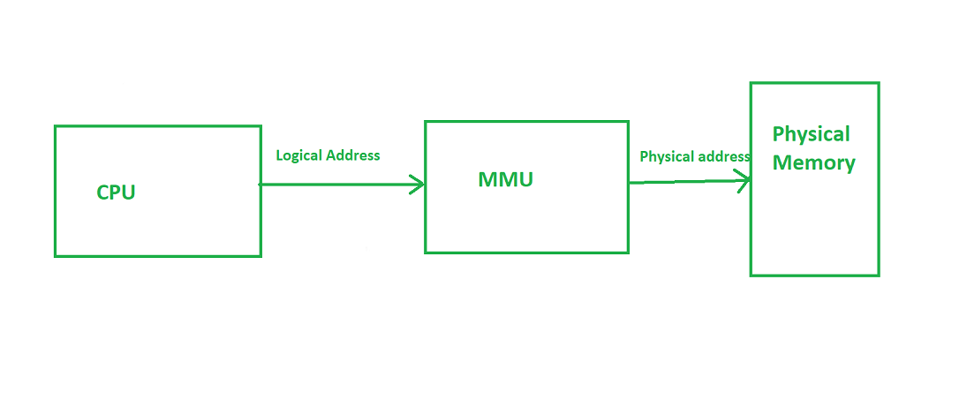
Introduction
Memory management hardware ensures efficient data access and storage.
It supports the CPU in translating logical addresses to physical addresses.
Main objectives:
  Address translation
  Memory protection
  Sharing and relocation
  Efficient memory utilization

Slide 3
Memory Hierarchy Overview
Memory is organized in a hierarchy based on speed, cost, and capacity:
  Registers → Cache → Main Memory → Secondary Storage
CPU interacts mainly with cache and main memory.
Hardware controls data movement between these levels.
Note:
Memory management hardware ensures data flow between levels for optimal performance.

Slide 4
Address Mapping and Translation
Content:
  CPU generates logical (virtual) addresses.
  These must be converted into physical addresses for memory access.
  The conversion is done by Address Mapping Hardware (part of MMU).
  Mapping can be direct, associative, or set-associative (depending on architecture).
Equation Example:
Physical Address = Base Register + Logical Address

Slide 5
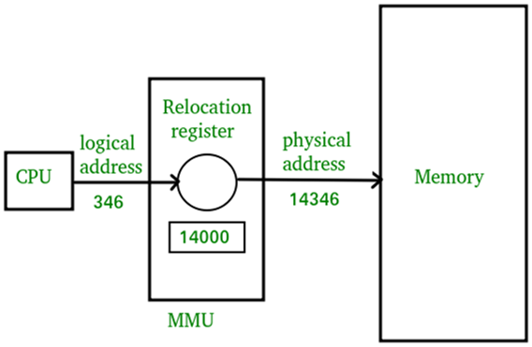
Memory Management Unit (MMU)
The MMU is a key component between the CPU and memory.
Responsibilities:
  Translate logical → physical addresses.
  Enforce protection (access rights).
  Manage relocation dynamically.
The MMU uses Base and Limit Registers or Page Tables for mapping.

Slide 6
Base and Limit Registers
Used in simple memory management schemes.
Base Register: Holds the starting physical address of a process.
Limit Register: Defines the range of valid addresses.
Every memory access is checked against these registers.
Example:
If Logical Address = 300, Base = 2000 → Physical Address = 2300
Access allowed if 300 < Limit
Advantage: Fast protection and relocation mechanism.

Slide 7
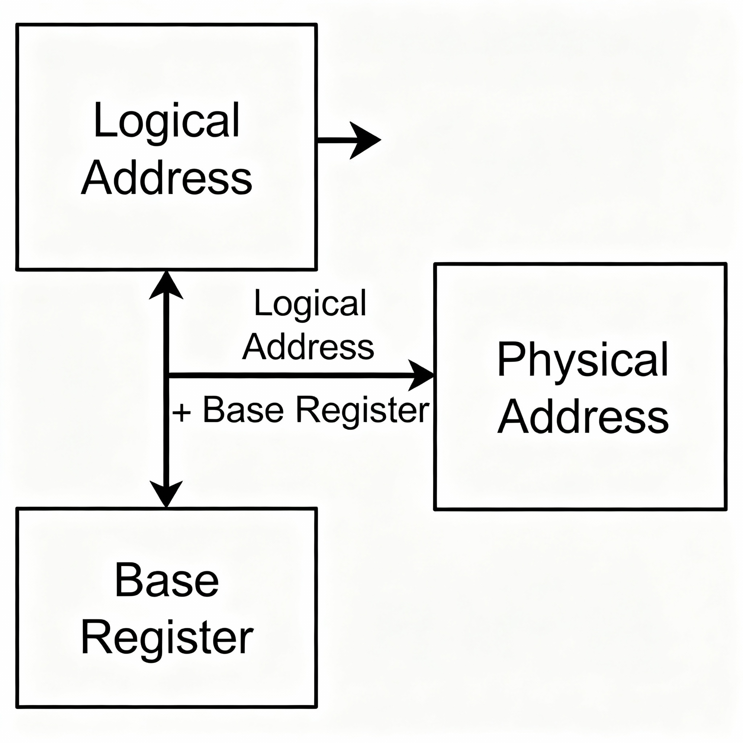
Dynamic Relocation
Allows a process to be moved in memory during execution.
Achieved by adding the base register value to each logical address at runtime.
Eliminates need to recompile or reload programs.
Ensures efficient memory use and flexibility.

Slide 8
Paging Hardware
Memory is divided into fixed-size blocks called pages and frames.
Each process has a page table that maps its pages to physical frames.
MMU uses page number and offset for address translation.
Example:
Logical Address = (Page no. = 2, Offset = 100)
→ Physical Address = Frame no. from Page Table + Offset
Hardware: Page Table stored in memory; TLB used for speed.

Slide 9
Translation Lookaside Buffer (TLB)
A high-speed associative memory inside the MMU.
Stores recently used page-to-frame mappings.
Reduces time required for address translation.
If match found in TLB → Fast access (TLB hit).
If not → MMU fetches from Page Table (TLB miss).
Formula:
Effective Access Time = (Hit Ratio × TLB Access) + (Miss Ratio × (TLB + Memory Access))

Slide 10
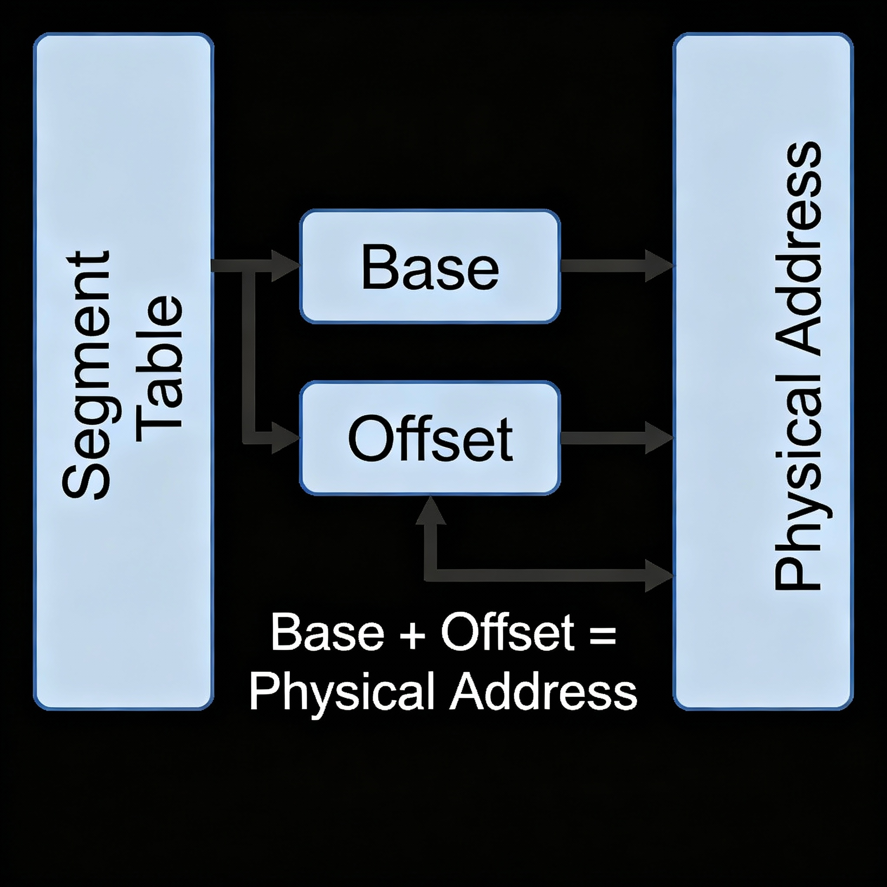
Segmentation Hardware
Divides memory based on logical program structure (code, stack, data).
Each segment has:
  Base Register (start address)
  Limit Register (segment length)
Enables protection and sharing at the segment level.

Slide 11
Protection and Sharing
Protection: Prevents illegal access using limit registers and page/segment tables.
Sharing: Allows multiple processes to use the same memory (e.g., shared code).
Access Control Bits: Read, Write, Execute permissions stored in tables.
Example:
Read-only code shared among processes safely.

Slide 12
Summary and Conclusion
Memory Management Hardware ensures:
  Efficient address translation (via MMU, TLB)
  Protection and isolation (via limit/base registers)
  Flexibility (via paging and segmentation)
Acts as the foundation for virtual memory systems in modern CPUs.
Key takeaway:
Hardware support is essential for reliable and high-speed memory operations.

Slide 13
THANK YOU

